Slide 1
MediaAlpha Applied
Project
UCLA MQE Spring 2021

Slide 2
Problem Statement
01
Exploratory Analysis
02
Table of contents
Predictive Model
03
Conclusion
04
Solution Approach
Publishers 55 and 299
Logistic Regression
Challenges, Lessons, Next Steps

Slide 3
01
Problem Statement

Slide 4
Key Question
What is the best way to rank ads in order to maximize revenue for publishers?
Can we do better than bid price?
Can we predict which ads will be clicked?

Slide 5
Solution Approach
Step 1
Step 2
Build a model that, given an ad’s position and a set of features about the ad and/or the user, predicts the probability that the ad is clicked.
Given a current ranking of ads, use the model to calculate the probabilities of alternative rankings. Assign rankings to maximize click probability or expected revenue.

Slide 6
02
Exploring the Data
Publishers 55 and 299

Slide 7
Why Separate Publishers?
1
2
3
Publishers each have their own distinct set of advertisers and user features
Prediction/ranking may not be equally effective for all publishers
Maximize revenue for each publisher

Slide 8
Publisher 55
Publisher 299
Largest publisher (most observations)
6,481,947 rows (impressions)
1,575,673 lead IDs (users)
Different characteristics from 55
3,841,936 rows (impressions)
600,556 lead IDs (users)

Slide 9
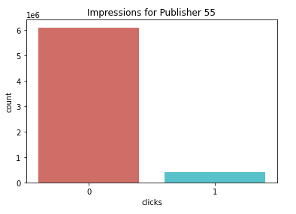
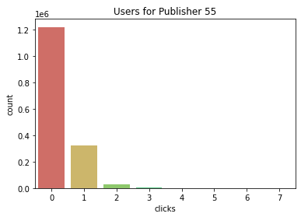
Click Rates for Publisher 55
~6% of impressions lead to clicks
~22% of users click at least once
~2% of users click more than once

Slide 10
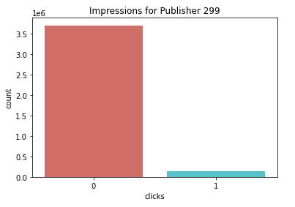
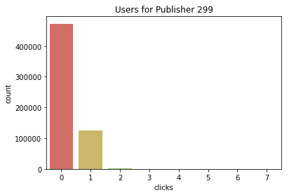
Click Rates for Publisher 299
~3.4% of impressions lead to clicks
~21% of users click at least once
~0.5% of users click more than once

Slide 11
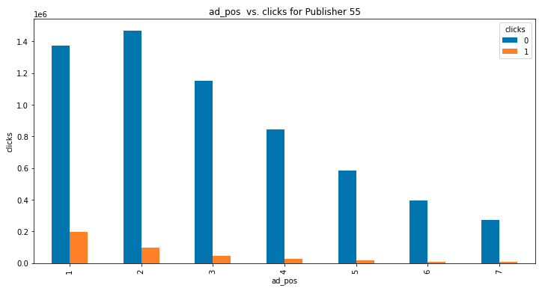
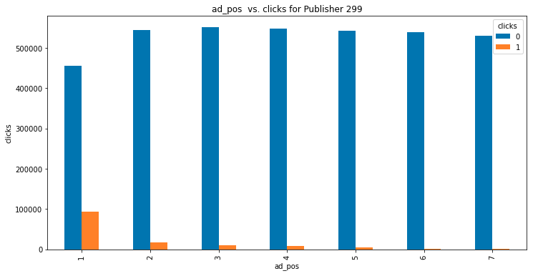
Ad Position vs Clicks
Ad position 1 has the highest click rate
Publisher 55 does not show the same number of ads to every user

Slide 12
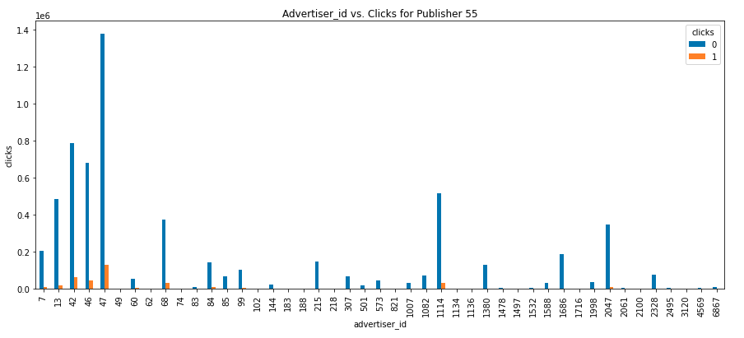
Advertisers for Publisher 55

Slide 13
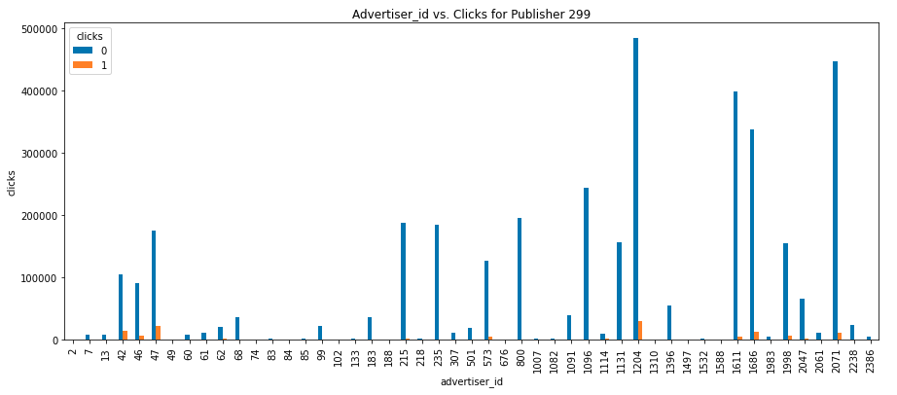
Advertisers for Publisher 299

Slide 14
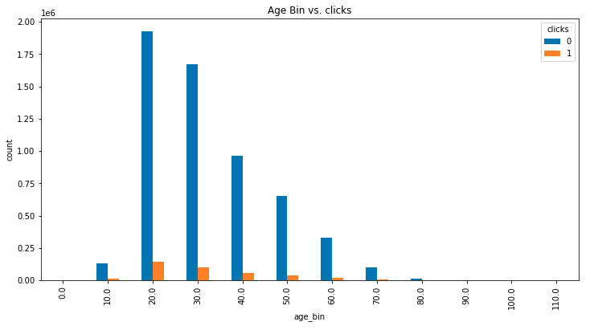
Age vs Clicks for Publisher 55

Slide 15
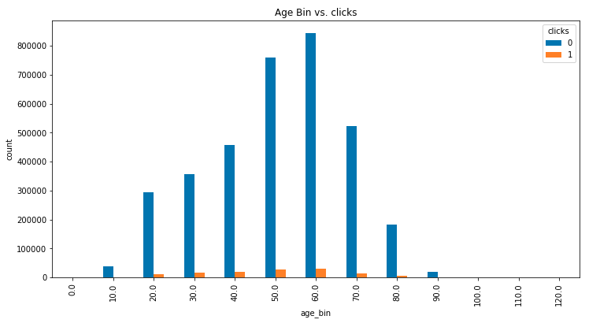
Age vs Clicks for Publisher 299

Slide 16
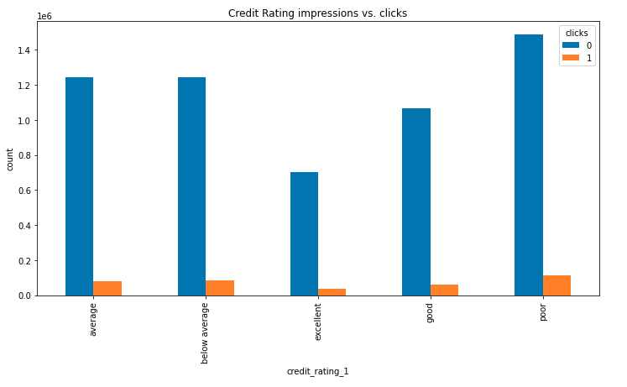
Credit Rating for Publisher 55
Click rate per impression
Poor: 7% click rate
Average: 6% click rate
Excellent: 4.6% click rate

Slide 17
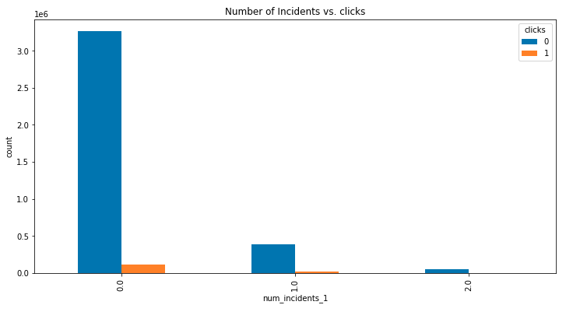
Num of Incidents for Publisher 299
Click rate per impression
No incidents: 3% click rate
1 incident: 5% click rate
2 incidents: 4.3% click rate

Slide 18
03
Building a Model
Logistic Regression

Slide 19
Highly Imbalanced Classes
Ratio of class 0 observations to class 1 observations is 15:1
Solution: undersample the majority class
Sample 20% of lead IDs (users), training set ratio is 5:1
Publisher 55 training observations: 1,516,729
Publisher 299 training observations: 840,833

Slide 20
Model Features
Python statsmodels logistic regression, separate model for each publisher
For both publishers:
Ad Position
Dummies for advertisers
Only if the number of observations exceeded 5000
Interactions between ad position and advertiser dummies
For publisher 55 only:
Age
Dummies for credit rating
For publisher 299 only:
Number of incidents

Slide 21
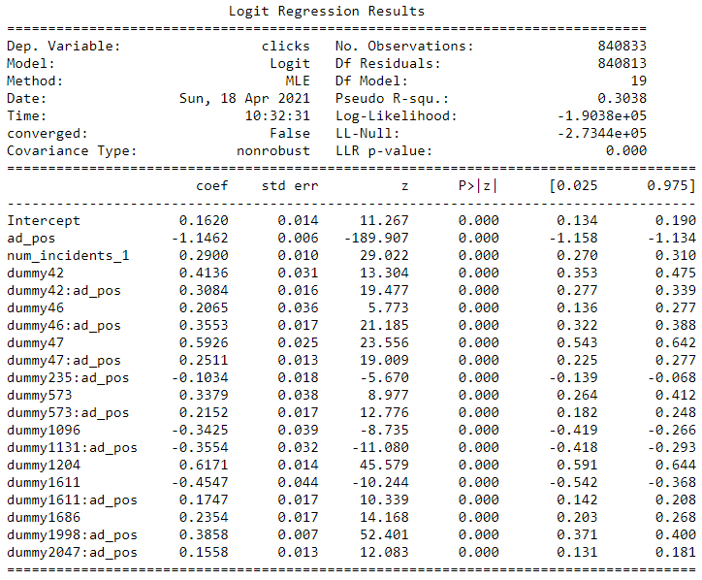
Interaction Effects
Additional combined effects on click rate between certain advertiser_id and ad_pos pairs
Generally positive
Notes:
Mention having to update parameters

Slide 22
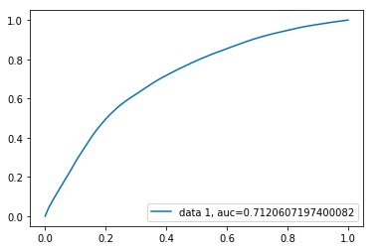
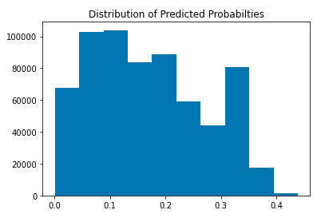
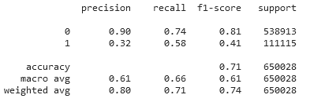
Model Evaluation: publisher 55
ROC Curve
Classification Matrix
Histogram of Probabilities
Threshold of 0.22

Slide 23
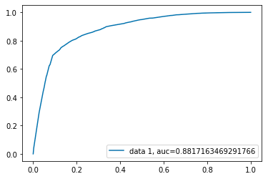
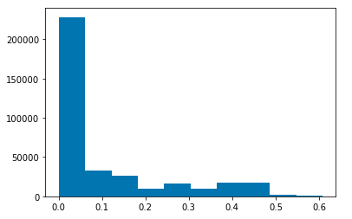
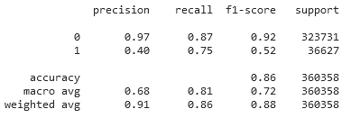
Model Evaluation: publisher 299
ROC Curve
Classification Matrix
Histogram Of Probabilities
Threshold of 0.22

Slide 24
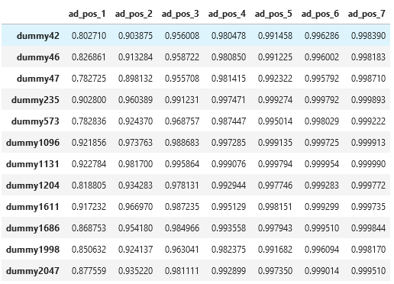
Example Cost Matrix
Optimize with linear_sum_assignment from scipy.optimize
Probabilities shown are 1 - Pr(click) for cost minimization
Could also multiply by adimpr_bid for expected revenue

Slide 25
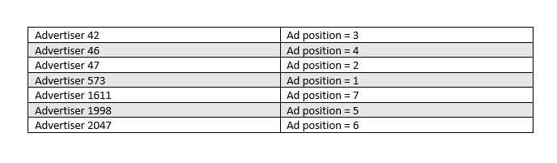
Proposed Ranking Algorithm
Proposed ranking algorithm obtained by the lowest cost pairs of linear sum assignment

Slide 26
04
Conclusion
Challenges, Lessons, Next Steps

Slide 27
Ranking Conclusions
Can’t say this method is superior to maximum bid
Hard to compare expected probabilities vs historical observed
A/B testing to validate
Business intuition: the right metric?
Click rate vs expected revenue
Converting no click users vs inducing multiple clicks

Slide 28
Challenges, Lessons, Next Steps
Imbalanced classes
Naive undersampling
Introduces bias, consider calibrating probabilities (see .ipynb)
Model improvements:
More granular features
Campaign, channel, image/text;
Additional features
Handling new data with missing values or new features
Increasing complexity
Online learning
Discarded models:
xgBoost
Naive Bayes

Slide 29
Thanks
Questions?
Anshika Sharma
Baojie Wang
Haichao Yu
Matthew Li

